Slide 1
Project 3
Unveiling The Recipe For Comedy Success:
Analyzing Viewer Preferences And Sentiment Towards Popular Sitcoms

Slide 2

01
Background Of The Problem

Slide 3
18 million
Average number of viewers tuning in to the last season of The Big Bang Theory
Source: https://web.archive.org/web/20190517210539/https://tvbythenumbers.zap2it.com/daily-ratings/thursday-final-ratings-may-16-2019/

Slide 4
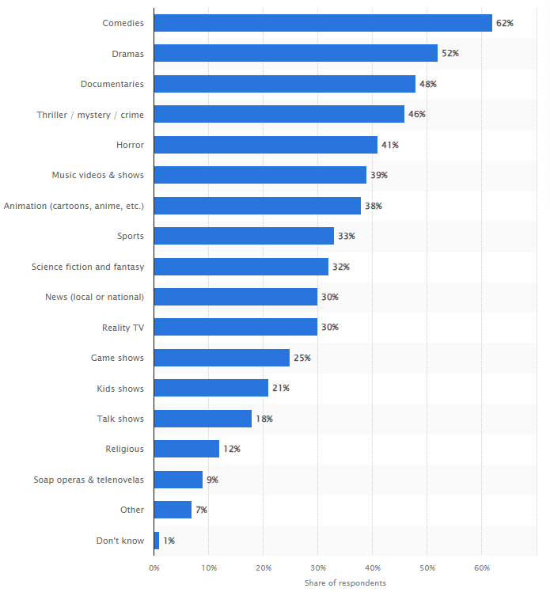
Preferred digital video content by genre in the U.S. as of March 2023
Source: https://www.statista.com/forecasts/997166/preferred-digital-video-content-by-genre-in-the-us#:~:text=%22Comedies%22%20and%20%22Dramas%22,the%20United%20States%2C%20in%202023.

Slide 5
01
02
Streaming
Services
Market
03
04
Netflix
223.09 million
subscribers
Prime Video
200+ million
subscribers
Disney+
164.2 million
subscribers
HBO Max
94.9 million
subscribers
Source: https://headphonesaddict.com/video-streaming-statistics/

Slide 6
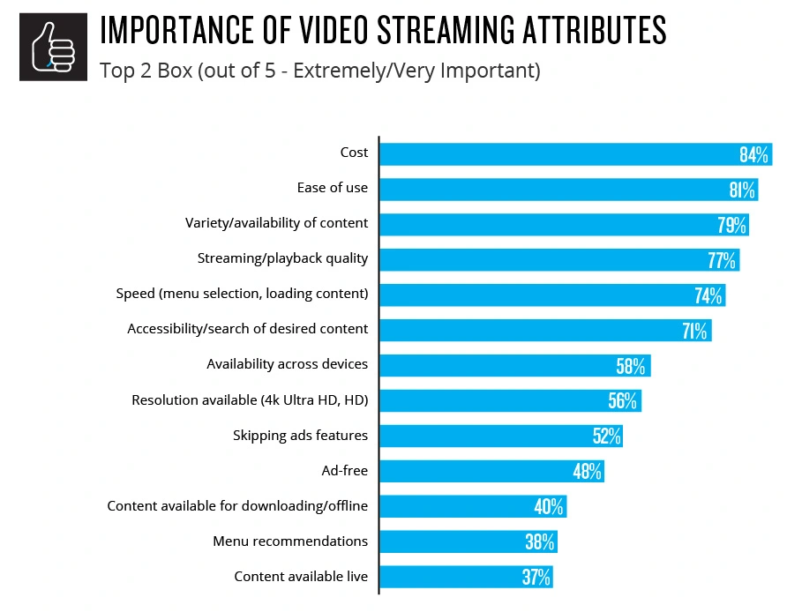
Availability of content is top 3 in importance of video streaming attributes
Source: https://www.nielsen.com/insights/2020/playback-time-which-consumer-attitudes-will-shape-the-streaming-wars/

Slide 7
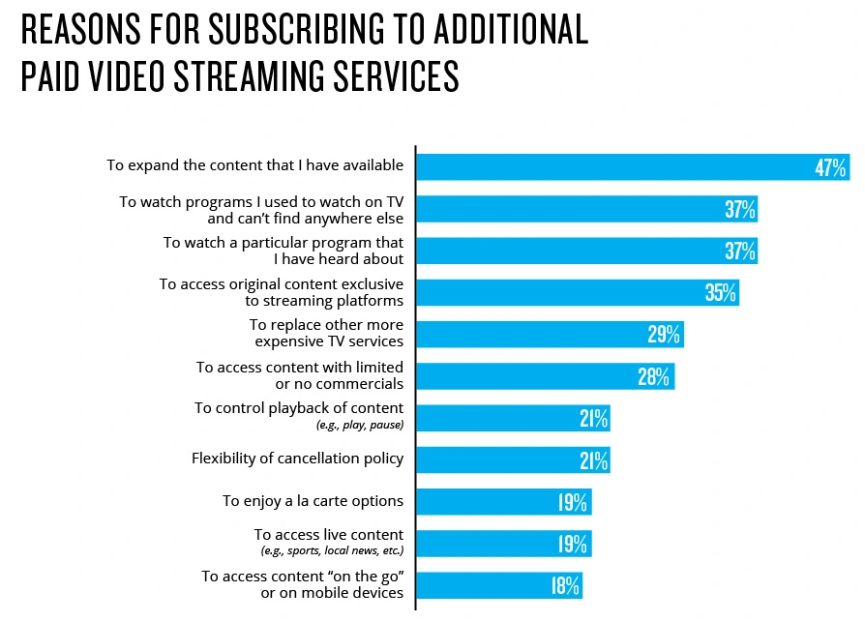
“Wanting to watch
programs they’ve heard about”
&
“To access original content exclusive to streaming platforms”
Are cited as top 3 & 4 reasons for subscribing to additional paid video streaming services
Source: https://www.nielsen.com/insights/2020/playback-time-which-consumer-attitudes-will-shape-the-streaming-wars/

Slide 8
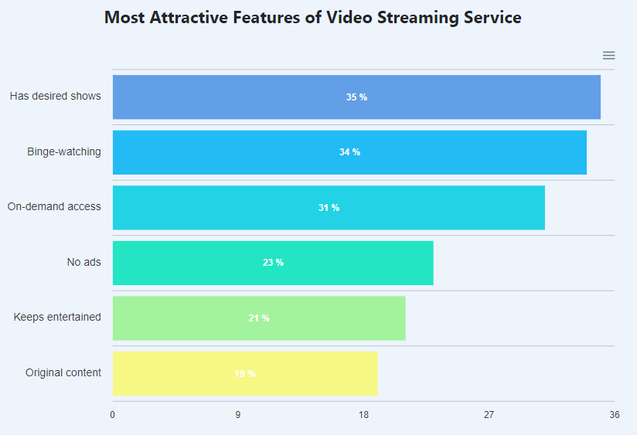
Desired shows
Is cited as the top reason that consumers found to be the most attractive feature of video streaming services
Source: https://www.cloudwards.net/streaming-services-statistics/

Slide 9
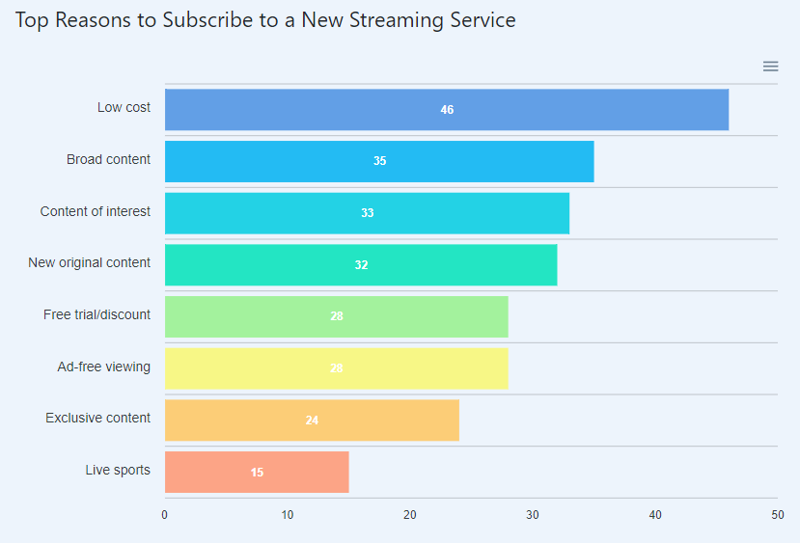
Content related reasons
Are also cited as the top reason that incites consumers to subscribe to new streaming services
Source: https://www.cloudwards.net/streaming-services-statistics/

Slide 10
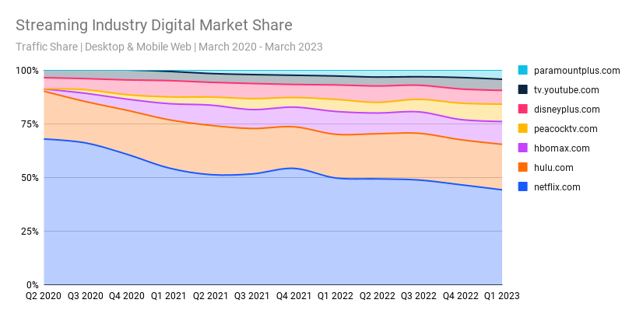
SVoD industry competitiveness
Netflix has been losing market share every year from 2020 - 2023, reason being that there are more competition in the market.
Source: https://www.similarweb.com/blog/insights/media-entertainment-news/streaming-q1-2023/#:~:text=The%20streaming%20industry%20has%20shown,in%20a%20post%2Dpandemic%20world.

Slide 11
When Singaporeans are asked if they would discontinue one of their streaming services in the next six months
39%
61%
Unlikely
Likely
Source: https://blackbox.com.sg/everyone/streaming-services-in-singapore

Slide 12
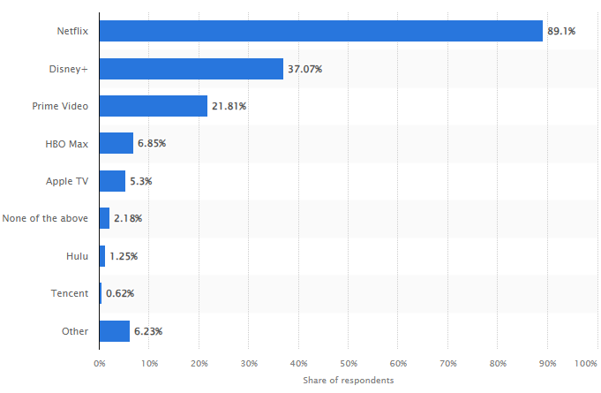
Most used streaming platforms among Singapore consumers in 2022
Source: https://www.statista.com/statistics/1341646/singapore-popular-streaming-platforms-among-consumers/

Slide 13
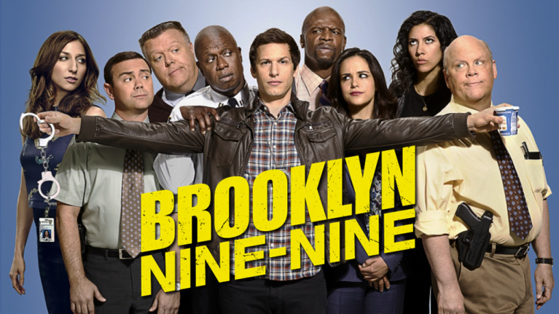
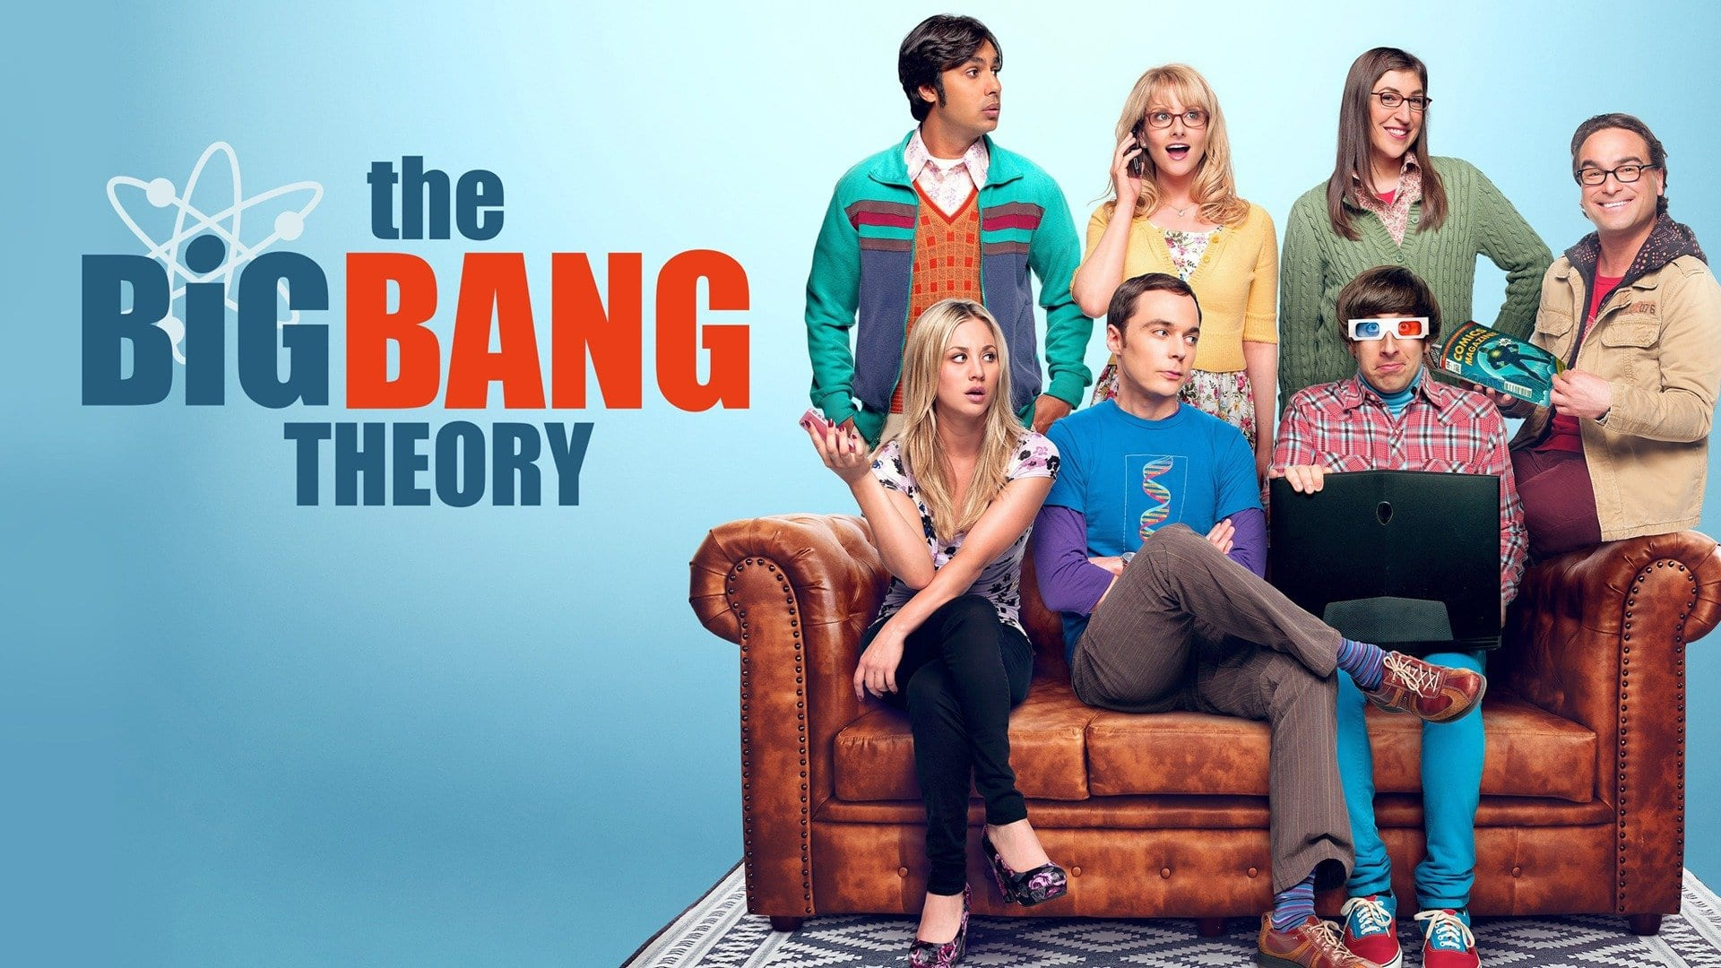
Problem Statement:
Short term problem
Identify what show elements in the sitcom are popular among the viewers
01
02
Brooklyn Nine-Nine
The Big Bang Theory
The team’s favorite sitcom that inspired the team’s name
One of the all time best sitcom and also one of the team’s favorites

Slide 14
Problem Statement:
Long term
To build an infrastructure that can help to classify and analyse user’s comments about the show from various platforms.
01
02
Classify comments by shows
Analyse sentiments from the comments

Slide 15
How we went about this
Scrape
EDA
Model
Deploy
Reddit
Discover
Classification
Decision making
We figured that the best way is to listen to the fans’ sentiment of their favourite shows
Any unexpected discoveries along with cleaning the data that will be used to train the model
Building and training classification models that would help to classify and determine the fans’ sentiment
Model would be deployed and the findings will be used in the decision making process of the problem

Slide 16
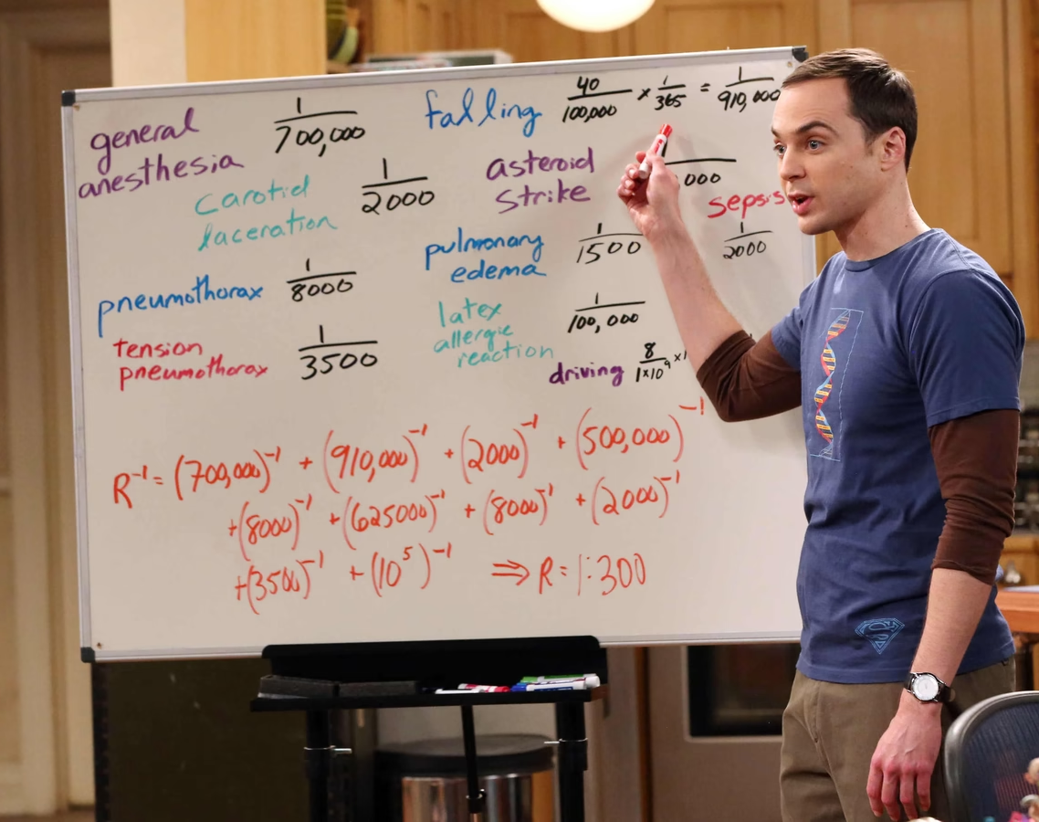
02
Exploratory
Data Analysis

Slide 17
Why Reddit?
Free to use
Freedom to express (unbiased input)
Simple Accessibility of Data
Large number of datasets (reduced biasness towards)
A genuine user reviews

Slide 18
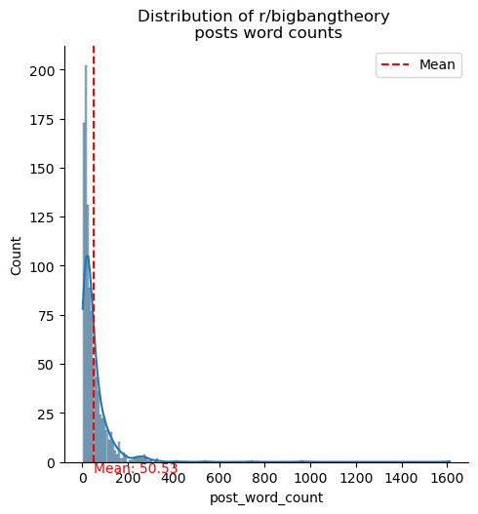
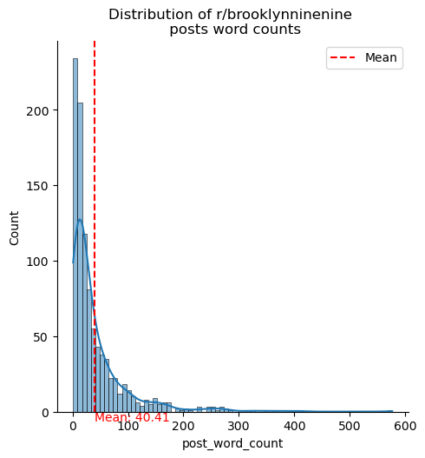
Word Counts per Post
r/bigbangtheory
50 words
r/brooklynninenine
40 words
Source: https://www.cloudwards.net/streaming-services-statistics/

Slide 19
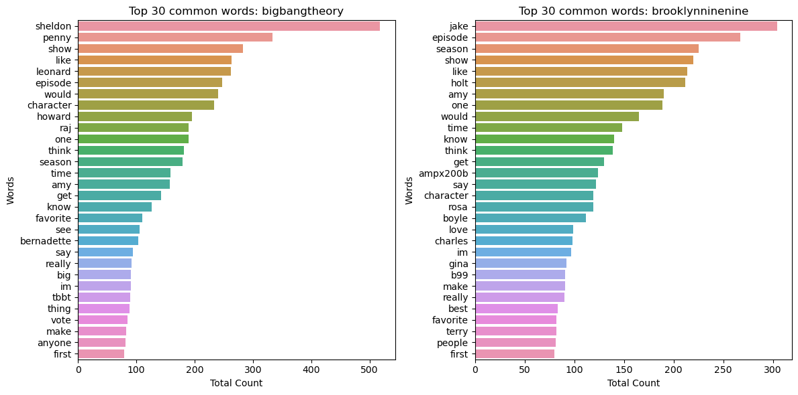
Top 30 Common Words
r/bigbangtheory
r/brooklynninenine
Common Words were observed
for
both subreddits

Slide 20
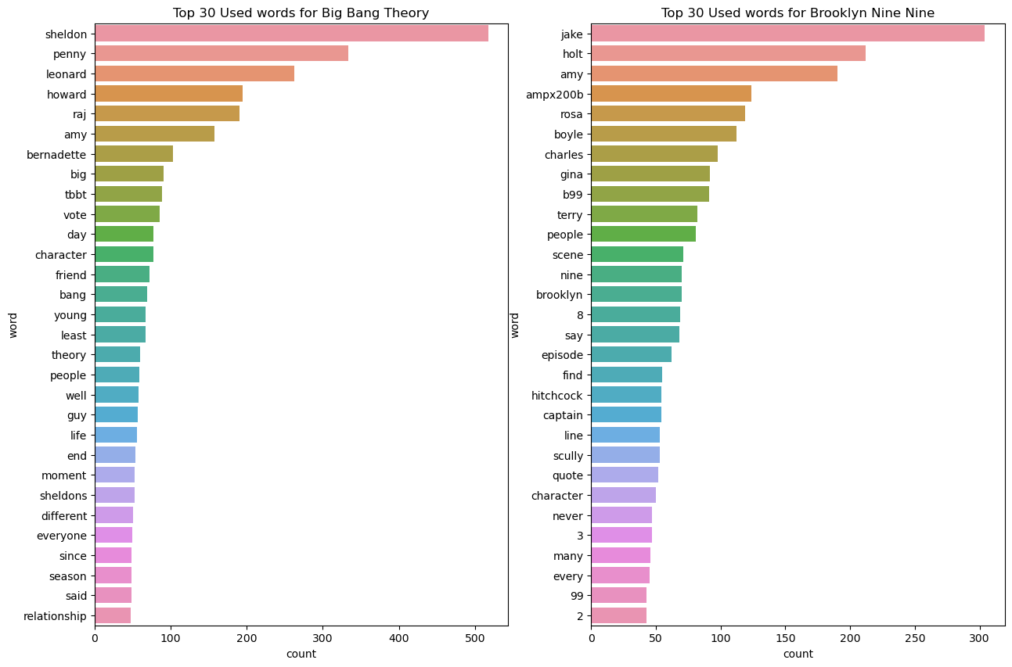
Top 30 after Countvectorizer
r/bigbangtheory
r/brooklynninenine
Character names are widely observed
‘Young’ is seen on BBT very often due to sequel
‘Season’ in BBT vs ‘Scene’ in B99

Slide 21
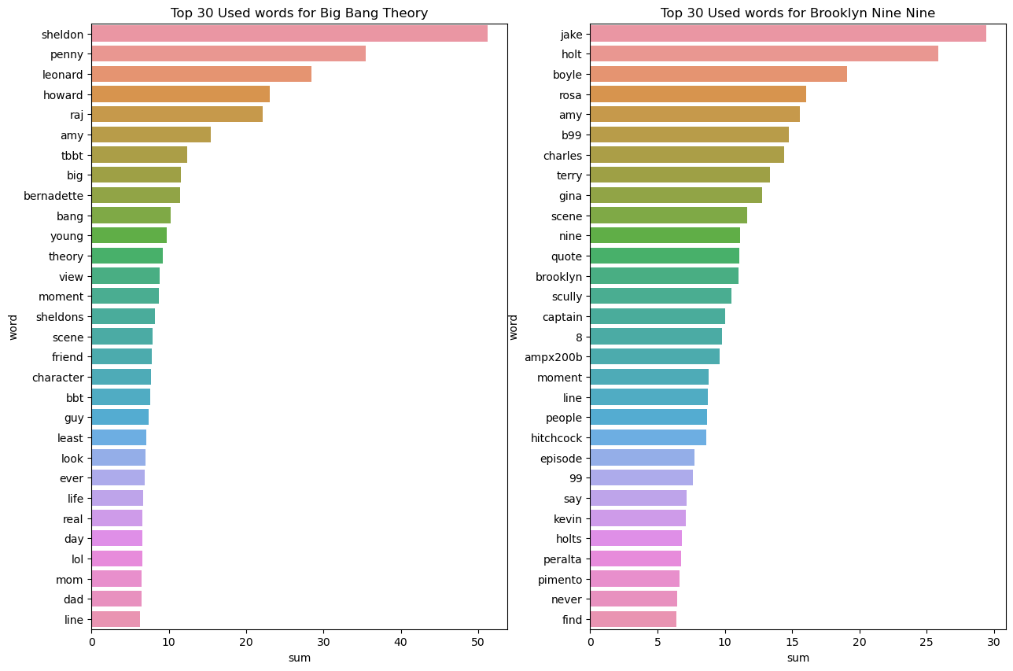
Similar Observations are found after TF-IDF Vectorizer with the same stopwords
r/bigbangtheory
r/brooklynninenine
Character names are widely observed
‘Young’ is seen on BBT very often due to sequel
‘Season’ in BBT vs ‘Scene’ in B99

Slide 22
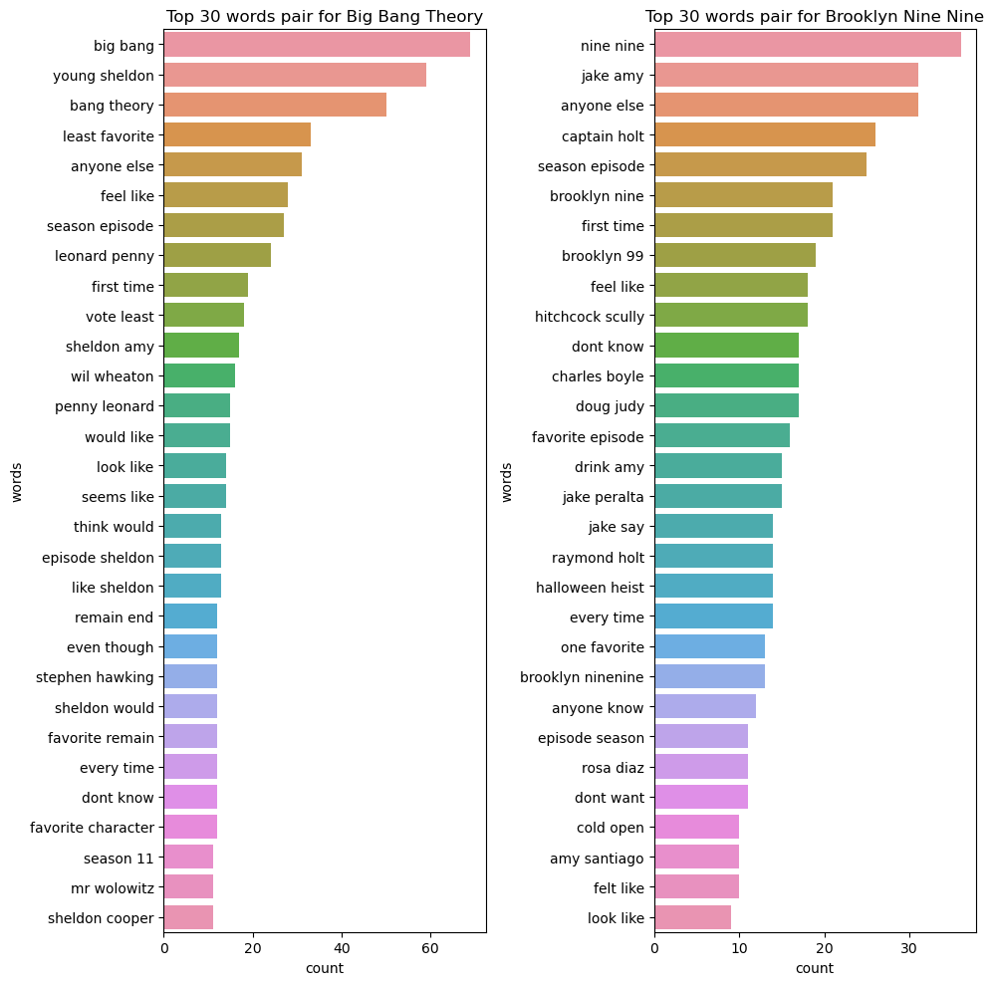
Top 30 Common Words after Bigrams
r/bigbangtheory
r/brooklynninenine
‘Least Favourite’ in BBT vs ‘favourite episode’ in B99
‘Sheldon’ has strong impact on viewers
‘Cold Open’ is a unique X-factor in B99
‘Halloween Heist’ is also a unique X-factor in B99

Slide 23
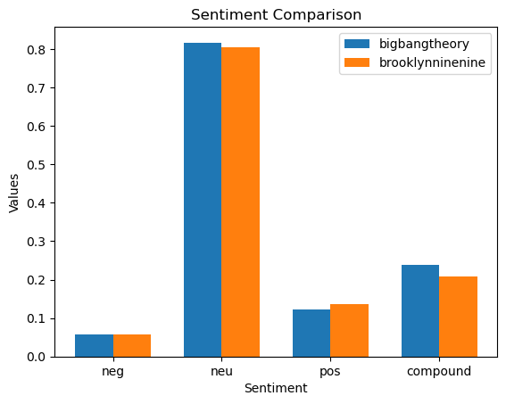
Sentiment Comparison
Majority are neutral words
Positive are 2x of Negative
BBT has SLIGHTLY HIGHER positive response than B99
‘Compound’ is Aggregate Score of the words

Slide 24
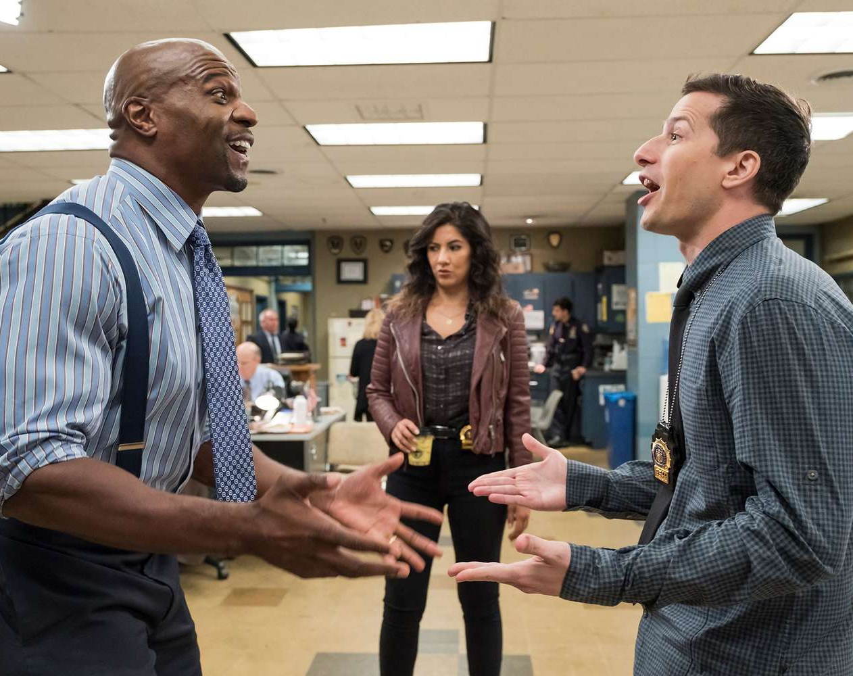
03
Classification Model

Slide 25
Ming Fatt et-al, 2023
“Disclaimer: This model is trained to predict the classification of a subreddit post based on the fans’ comments about the show, and not the content of the show itself.

Slide 26
What did we do?
18
>9k
01
Models
Baseline XG Boost
Hyperparameter tuning
18 Models were made during the process of training and building this classification model
More than 9,000 fits was attempted to tune the hyper parameters of the model
Boosting method was attempted to increase the performance of the model

Slide 27
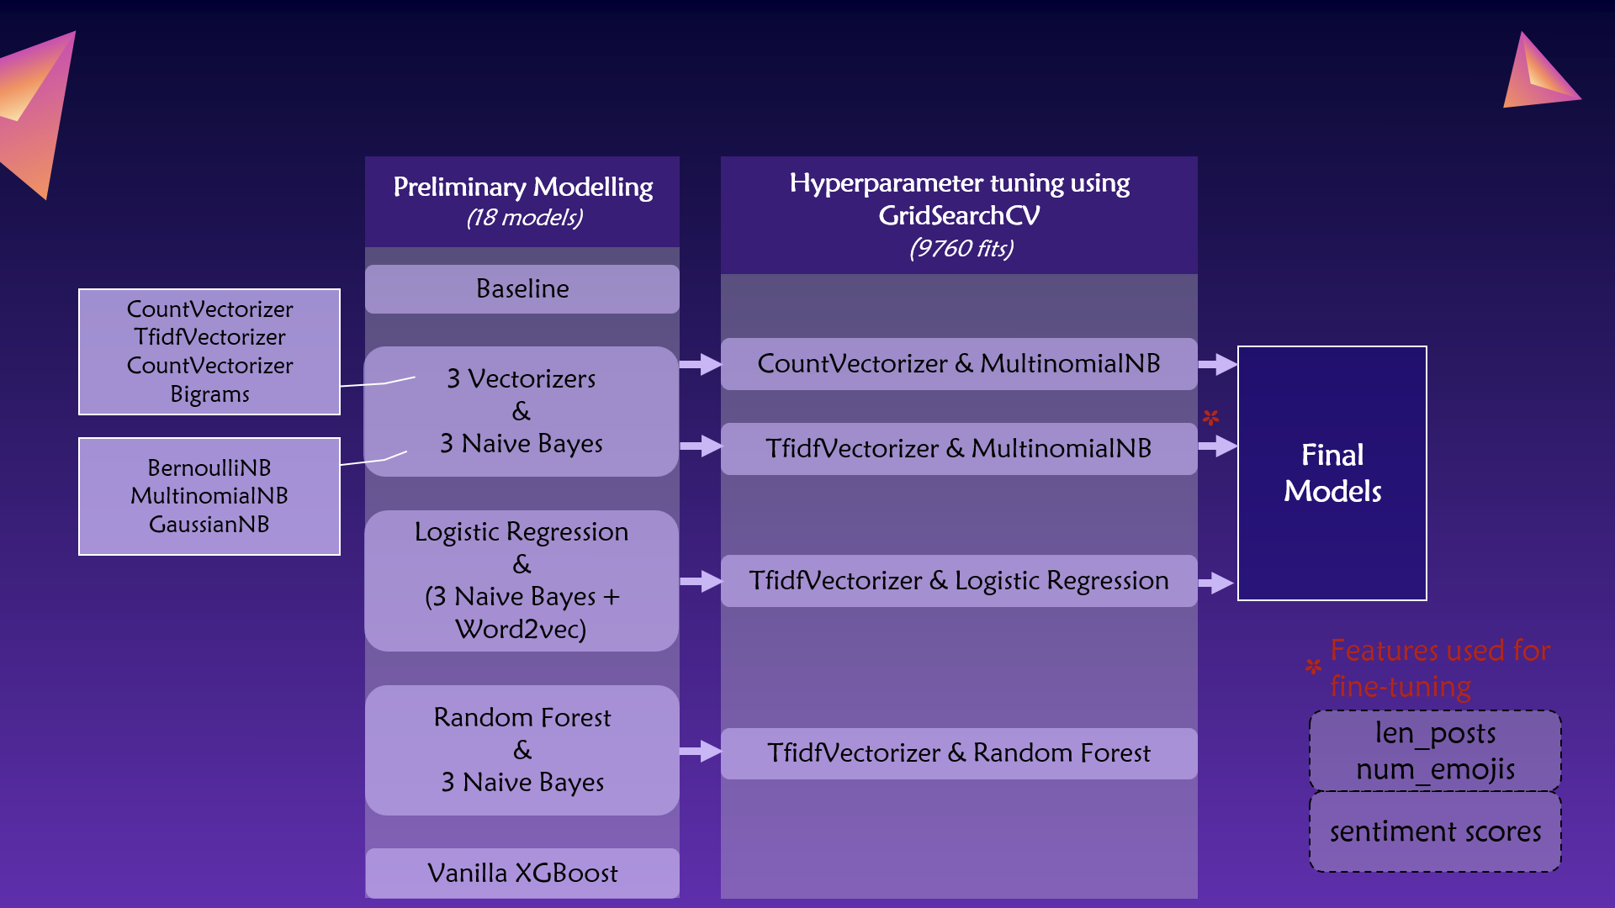
Modelling workflow

Slide 28
Summary Table Score
 | Accuracy (Train) | Accuracy (Test) | Cross Validation Score
Baseline Model | 0.520833 |  | NA
Multinomial(NB) + CountVect + GridSearchCV | 0.97050 | 0.90653 | 0.88123
Logistic Regression + TF-IDF + GridSearchCV | 0.97957 | 0.90652 | 0.87368
Multinomial(NB) + TF-IDF + GridSearchCV | 0.98865 | 0.92063 | 0.87973
Best Model Hyperparameters:
TfidfVectorizer: max_df=0.9, max_features=max_features, min_df=1
MultinomialNB: alpha=0.5, fit_prior=True

Slide 29
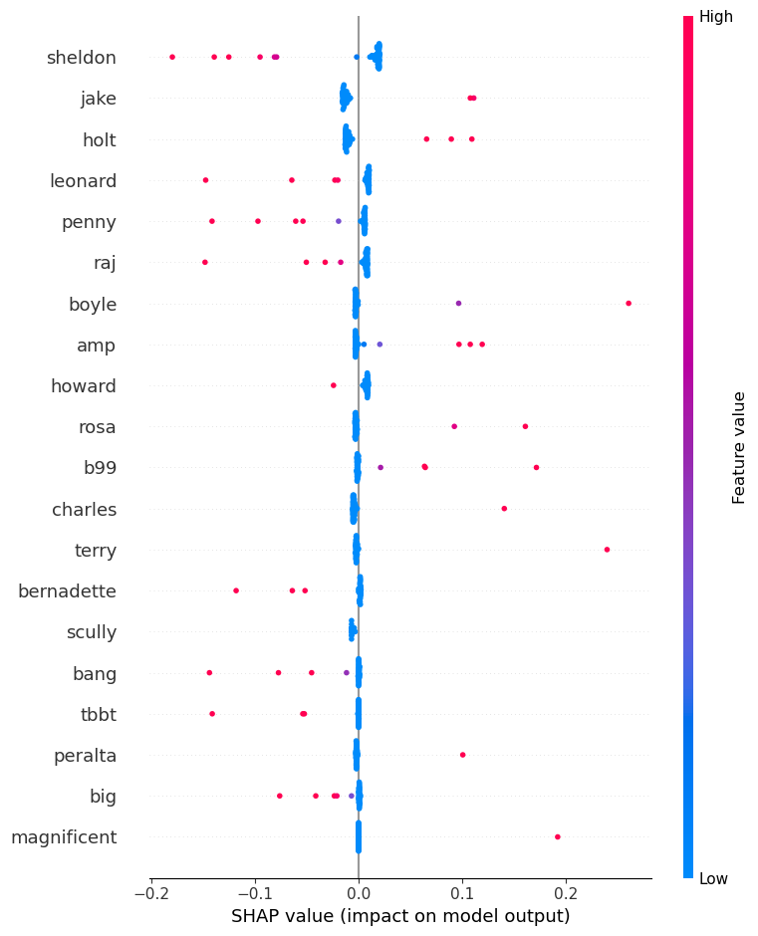
Features Importance
brooklynninenine
bigbangtheory
The character importances was doubly assured by the SHAP plot.
Sheldon is the most important feature for bigbagtheory
Jake is the most important feature for brooklynninenine

Slide 30
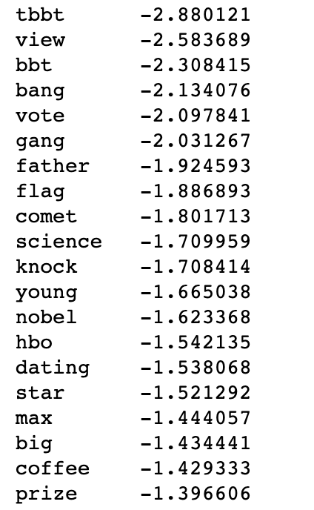
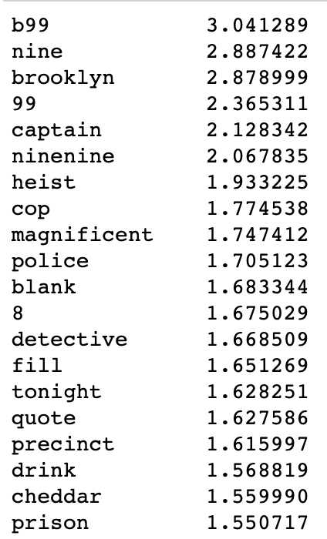
Features Importance
(Without Characters)
brooklynninenine
bigbangtheory
There are distinct features from each class.
Positive: Class 1
Negative: Class 0
HBO is mentioned but netflix is not.

Slide 31
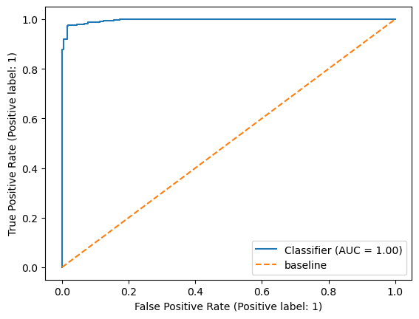
ROC AUC curve
The bigger the area under curve, the better our model accuracy.
The best score one can get in AUC Classifier is 1.
Our best model achieved an accuracy of 0.996, rounded to 1 by machine.

Slide 32
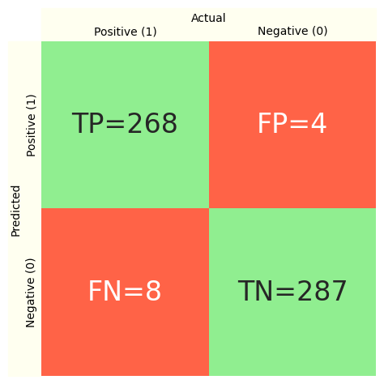
Confusion Matrix
Misclassified posts analysis
For FP and FN posts, after TF-IDF Vectorisation was carried out, only the word ‘season’ was wrongly classified
‘Season’ is in top 30 common words for both sitcoms

Slide 33
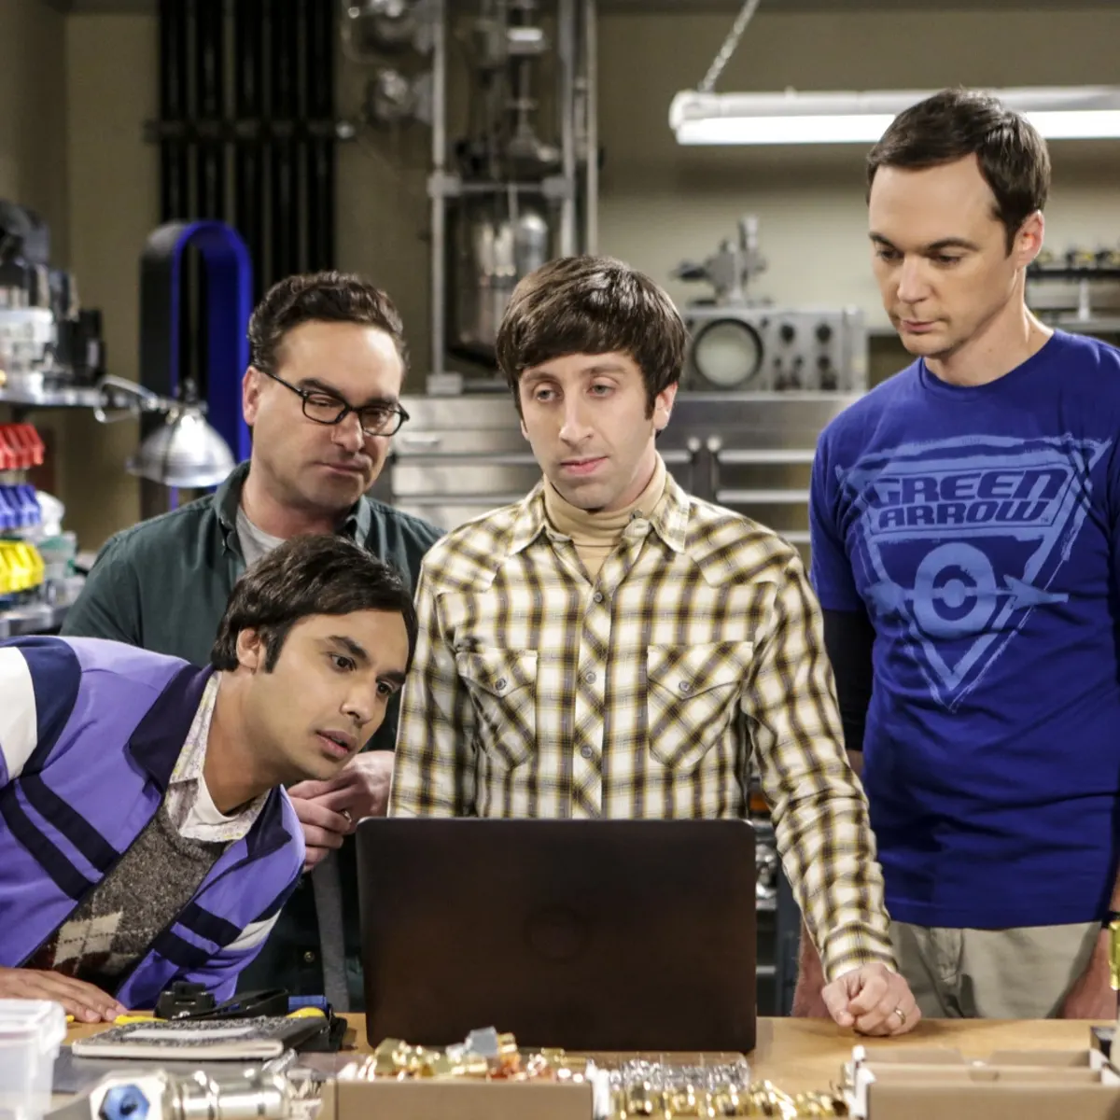
04
Product Demonstration

Slide 34

05
Recommendation and Key Insights

Slide 35
Key Insights
Show Elements
Hot Topics
Character Names
‘Cold Open’
‘Halloween Heist’
‘Potential Sequel’
Favorite Character
Least Favorite Scene
All characters are repeatedly mentioned

Slide 36
Key Recommendations
01
02
03
In new shows/future seasons,
Build Memorable Characters
‘Cold Open’ for every episode
Periodical events like ‘Halloween Heist’
The characters come with a moment/scene!

Slide 37
Future Work
Model can be expanded to Multi-Class Classification
Further collect text inputs from other sources periodically
To perform further sentiment analysis

Slide 38
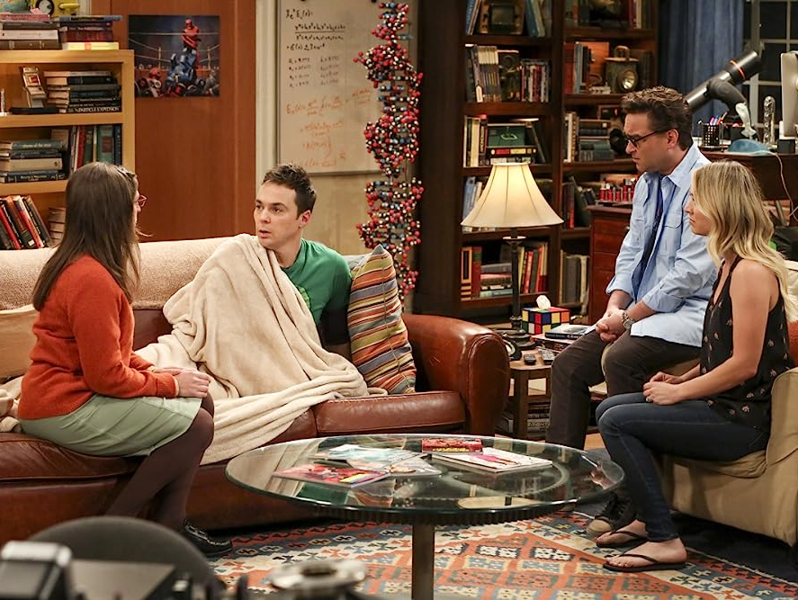
06
Key Limitations

Slide 39
Misclassified
Words
Predicted as B99 with 51.51% probability.
Caltech
Supersymmetry
Anakin Skywalker
Yoda
Amy
Cheese Cake

Slide 40
Project Goals Revisit:
Identify what show elements in the sitcom are popular among the viewers
To build an infrastructure that can help to classify and analyse user’s comments about the show from various platforms.

Slide 41
Future Work
Model can be expanded to Multi-Class Classification
Further collect text inputs from other sources periodically
To perform further sentiment analysis

Slide 42
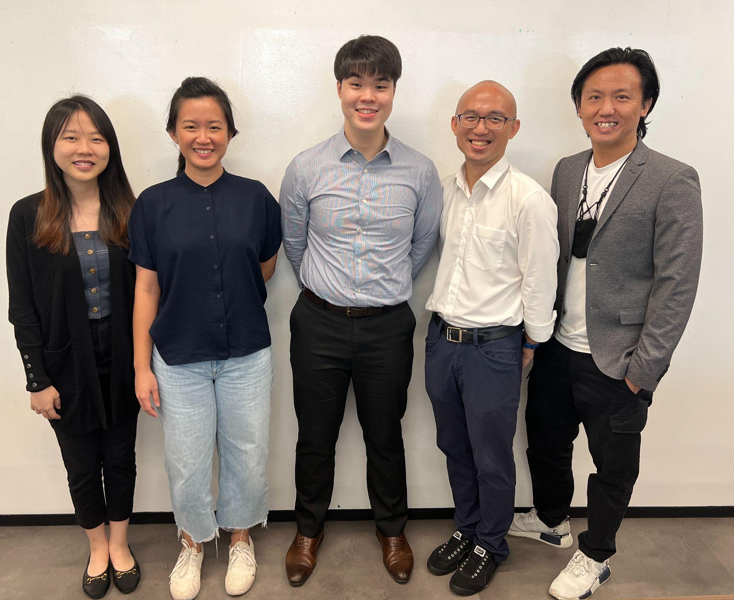
Thank you!

Slide 43
Grid Search Results (top 3 out of 4)
CountVectorizer with MultinomialNB
Best Hyperparameters: {'cv__max_df': 0.9, 'cv__max_features': 9425, 'cv__min_df': 1, 'nb__alpha': 0.5, 'nb__fit_prior': False}
Best training accuracy: 0.881232132647227
Test set accuracy score for best params: 0.9065255731922398
TfidfVectorizer with MultinomialNB
Best Hyperparameters: {'nb__alpha': 0.5, 'nb__fit_prior': True, 'tf__max_df': 0.9, 'tf__max_features': 9425, 'tf__min_df': 1}
Best training accuracy: 0.8797284162378503
Test set accuracy score for best params: 0.9206349206349206
TfidfVectorizer with LogisticRegression
Best Hyperparameters: {'lr__C': 1.0, 'lr__penalty': 'l2', 'lr__solver': 'liblinear', 'tf__max_df': 0.9, 'tf__max_features': 5000, 'tf__min_df': 1}
Best training accuracy: 0.8736821040594627
Test set accuracy score for best params: 0.9065255731922398

Slide 44
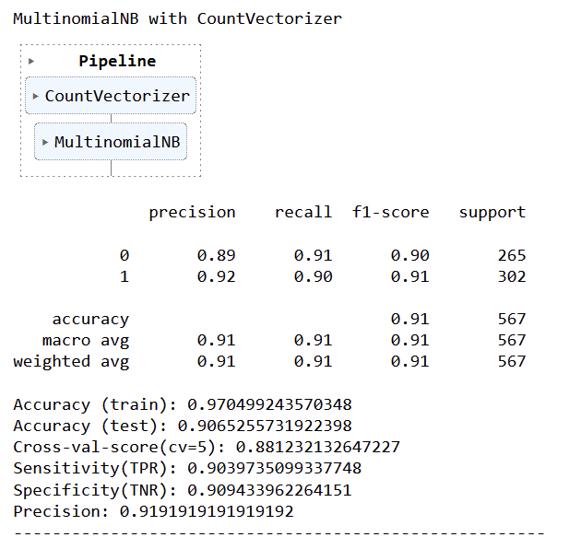
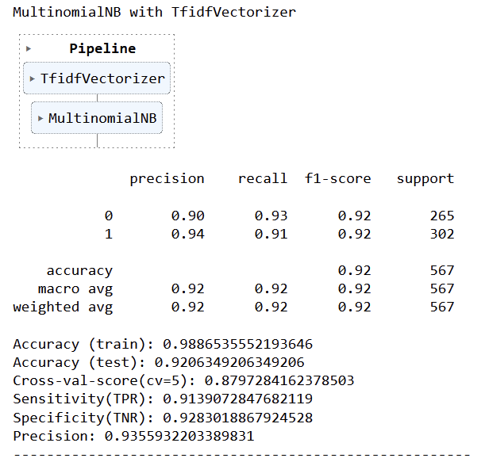
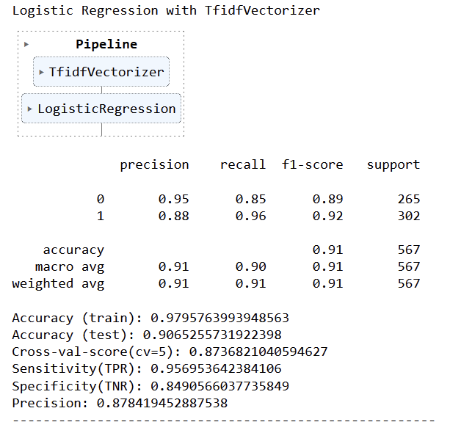
Final models (parameters taken from grid search)

Slide 45
Modelling workflow
Baseline
Count
Vectorizer
Multinomial NB
Final Model
*
3 Vectorizer
3 Naive
Bayes
TFIDF Vectorizer
Multinomial NB
Preliminary
Modelling
Further analysis:
len_posts, num_emojis
Sentiment Analysis
Logistic Regression
3 Naive
Bayes
TFIDF Vectorizer
Logistic Regression
*Note
Vectorizers: CountVectorizer
Bigram CountVectorizer, TFIDFVectorizer
Naive Bayes:
Bernoulli, Multinomial, Gaussian
Random
Forest
3 Naive
Bayes
TFIDF Vectorizer
Random Forest
Vanilla XG
Boost
GridSearchCV applied

Slide 46
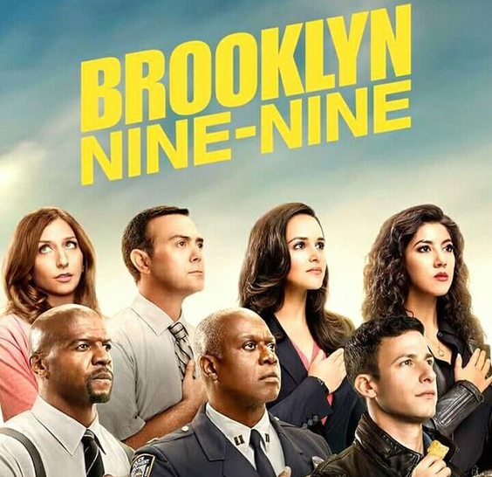
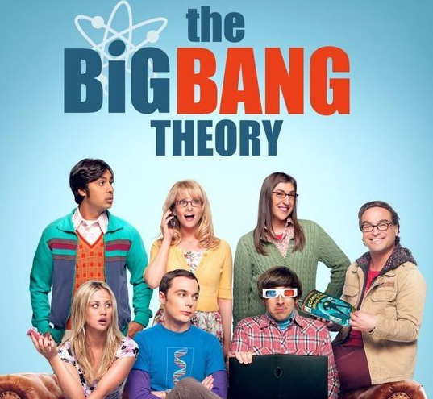
Meet the production team
Show Classifier
Sentiment Analysis
Classifies the show
Analyse Sentiments

Slide 47
END

